Slide 1
Beep: Left Behind Items Detection in Autonomous Public Transport
Sahil Bishnoi

Slide 2

Project Purpose
Utilize Computer Vision: Implement computer vision techniques to identify and track items brought by passengers.
Association and Alert Mechanism: Associate items with their respective owners as they enter the autonomous public transport vehicle and trigger an alert if any item is left behind when the passenger exits.
Enhance Security and Convenience: Improve security and convenience for passengers by ensuring no items are left behind.
Notes:
Img credits: https://empireflippers.com/social-media-dtc-ecommerce/

Slide 3
Object Detection and Tracking
We have a camera feed from the inside of the vehicle and we need to reliably detect the people and items in the camera feed.
YOLOv7 (You Only Look Once): A single-stage object detector for object detection.
Pretrained on COCO Dataset: YOLOv7 is pretrained on the COCO dataset, which has 80 different labels and can accurately detect these classes.
ByteTrack: Used for assigning unique tracking IDs to maintain consistent tracking of detected objects across frames.

Slide 4
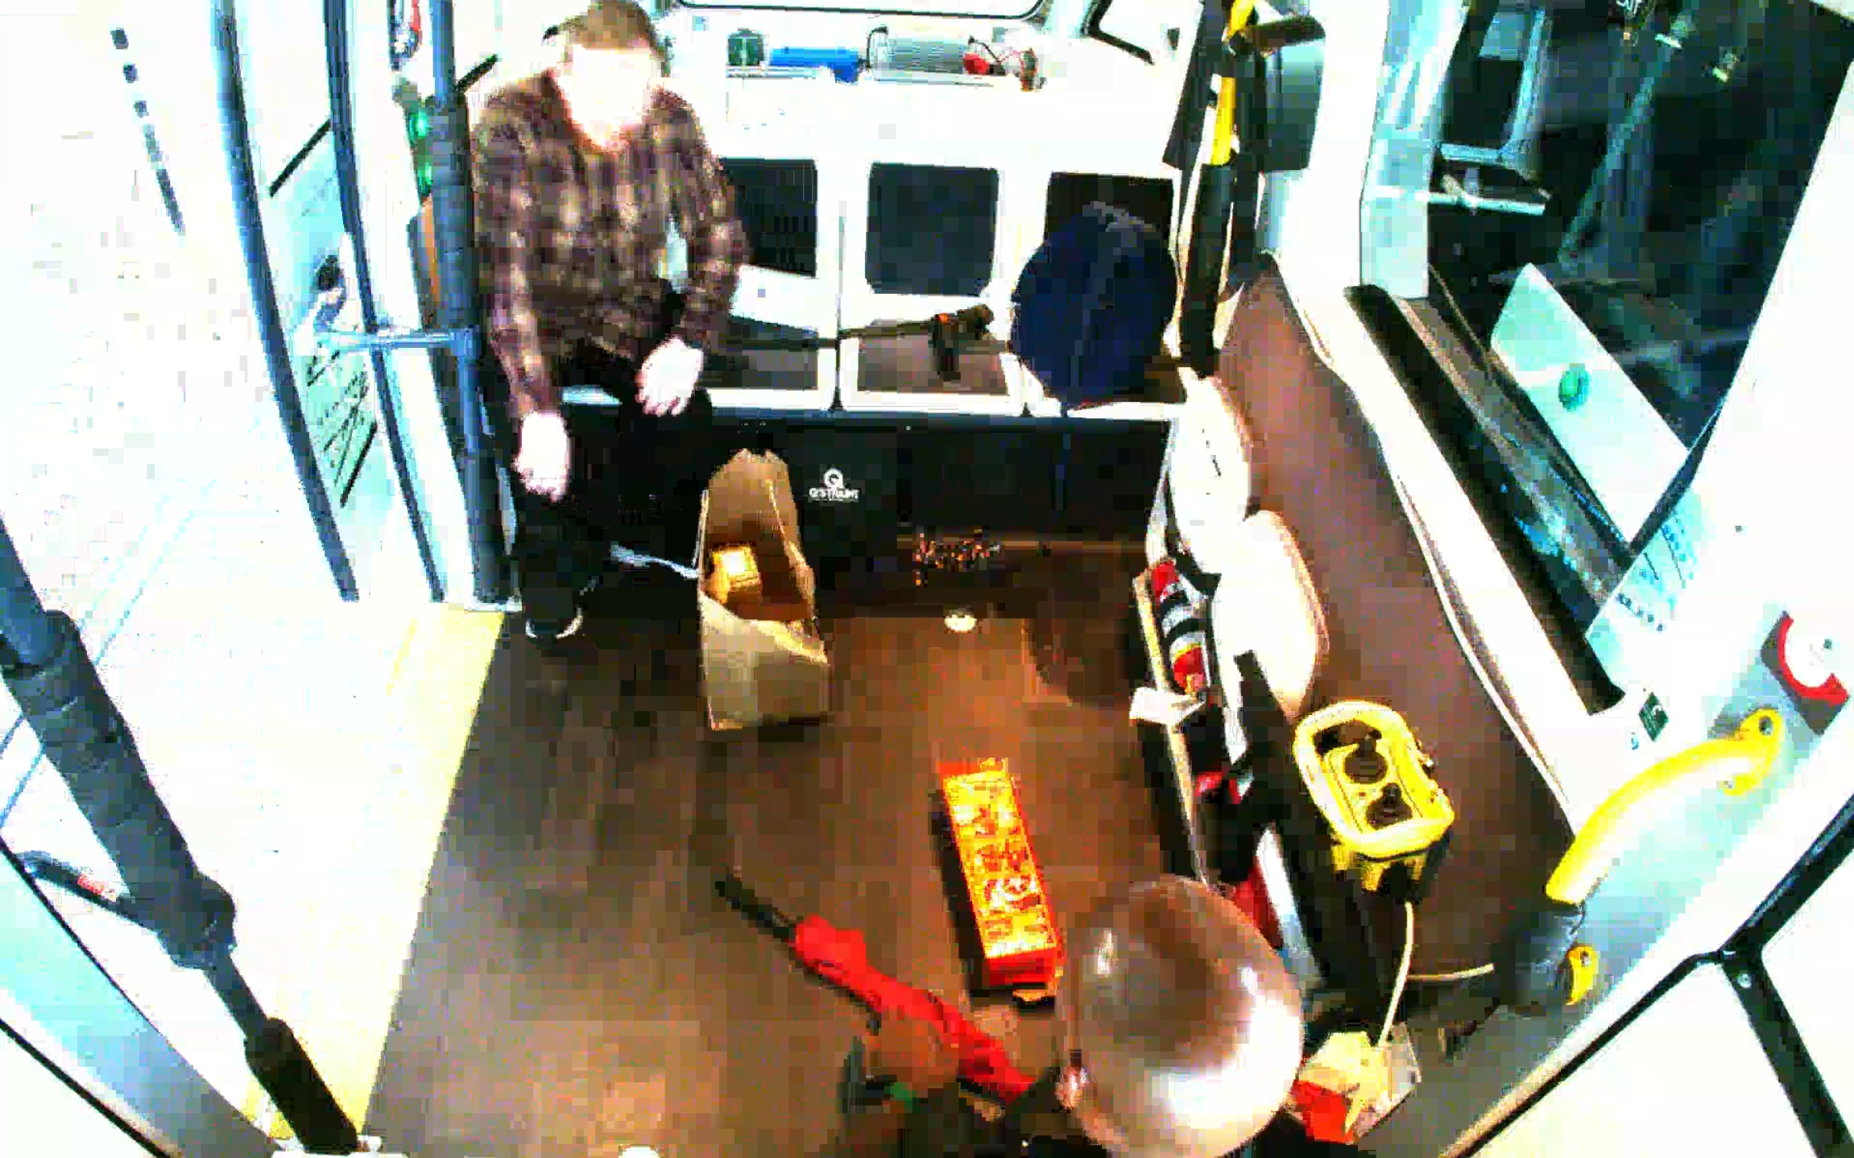
Raw video frame from the camera feed

Slide 5
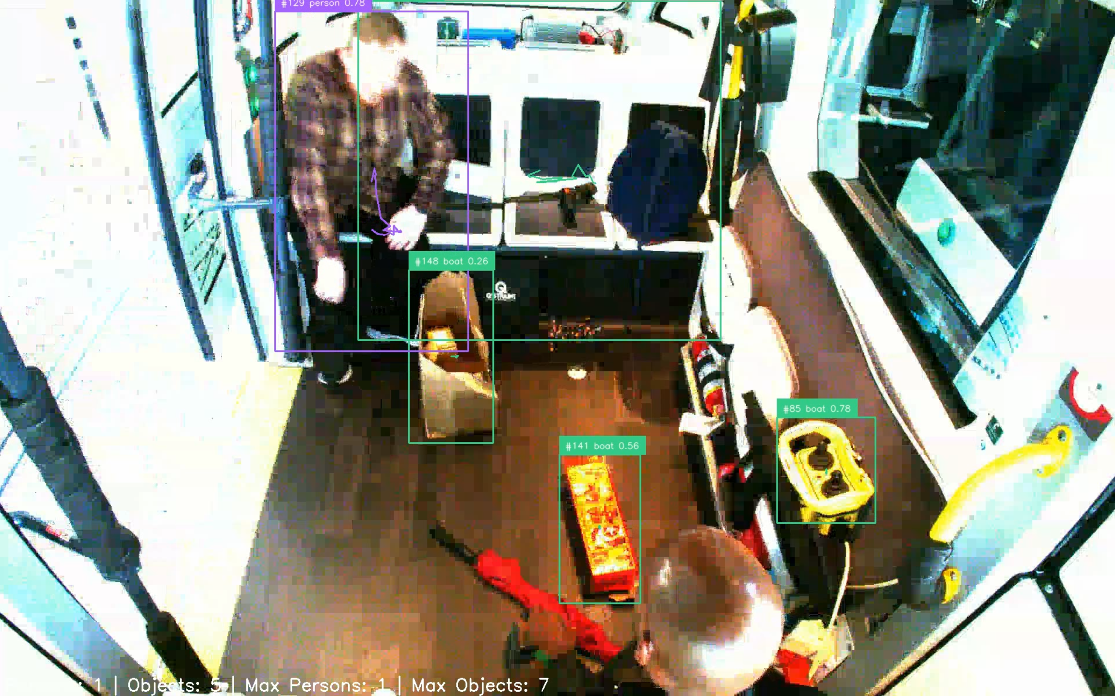
Annotate frame after object detection & tracking
Tracking ID (#129, from ByteTrack)
Class Name (person, label from COCO dataset)
Detection Confidence (78%)
Unwanted detections
Within the current scope of the project, we are primarily concerned with detecting items rather than identifying specific items. To improve detection accuracy, we can train the YOLO model on a custom image dataset comprising images of common items from the camera feed. This training will account for factors such as camera quality, lighting conditions, and camera angles.

Slide 6
Reducing Object Detection Noise
The real-time video feed from the vehicle is not of the highest bitrate. Some items are always present in the vehicle and do not contribute to the problem we are trying to solve.
Irrelevant detections are filtered out based on class IDs, and unwanted large detections are filtered out based on the relative size of the bounding box compared to the frame size.
A polygon zone was developed to filter out all detections outside the specified zone, counting only objects and people within the zone. This reduces noise from objects that are always present in the vehicle and are not relevant for our detection and tracking purposes.

Slide 7
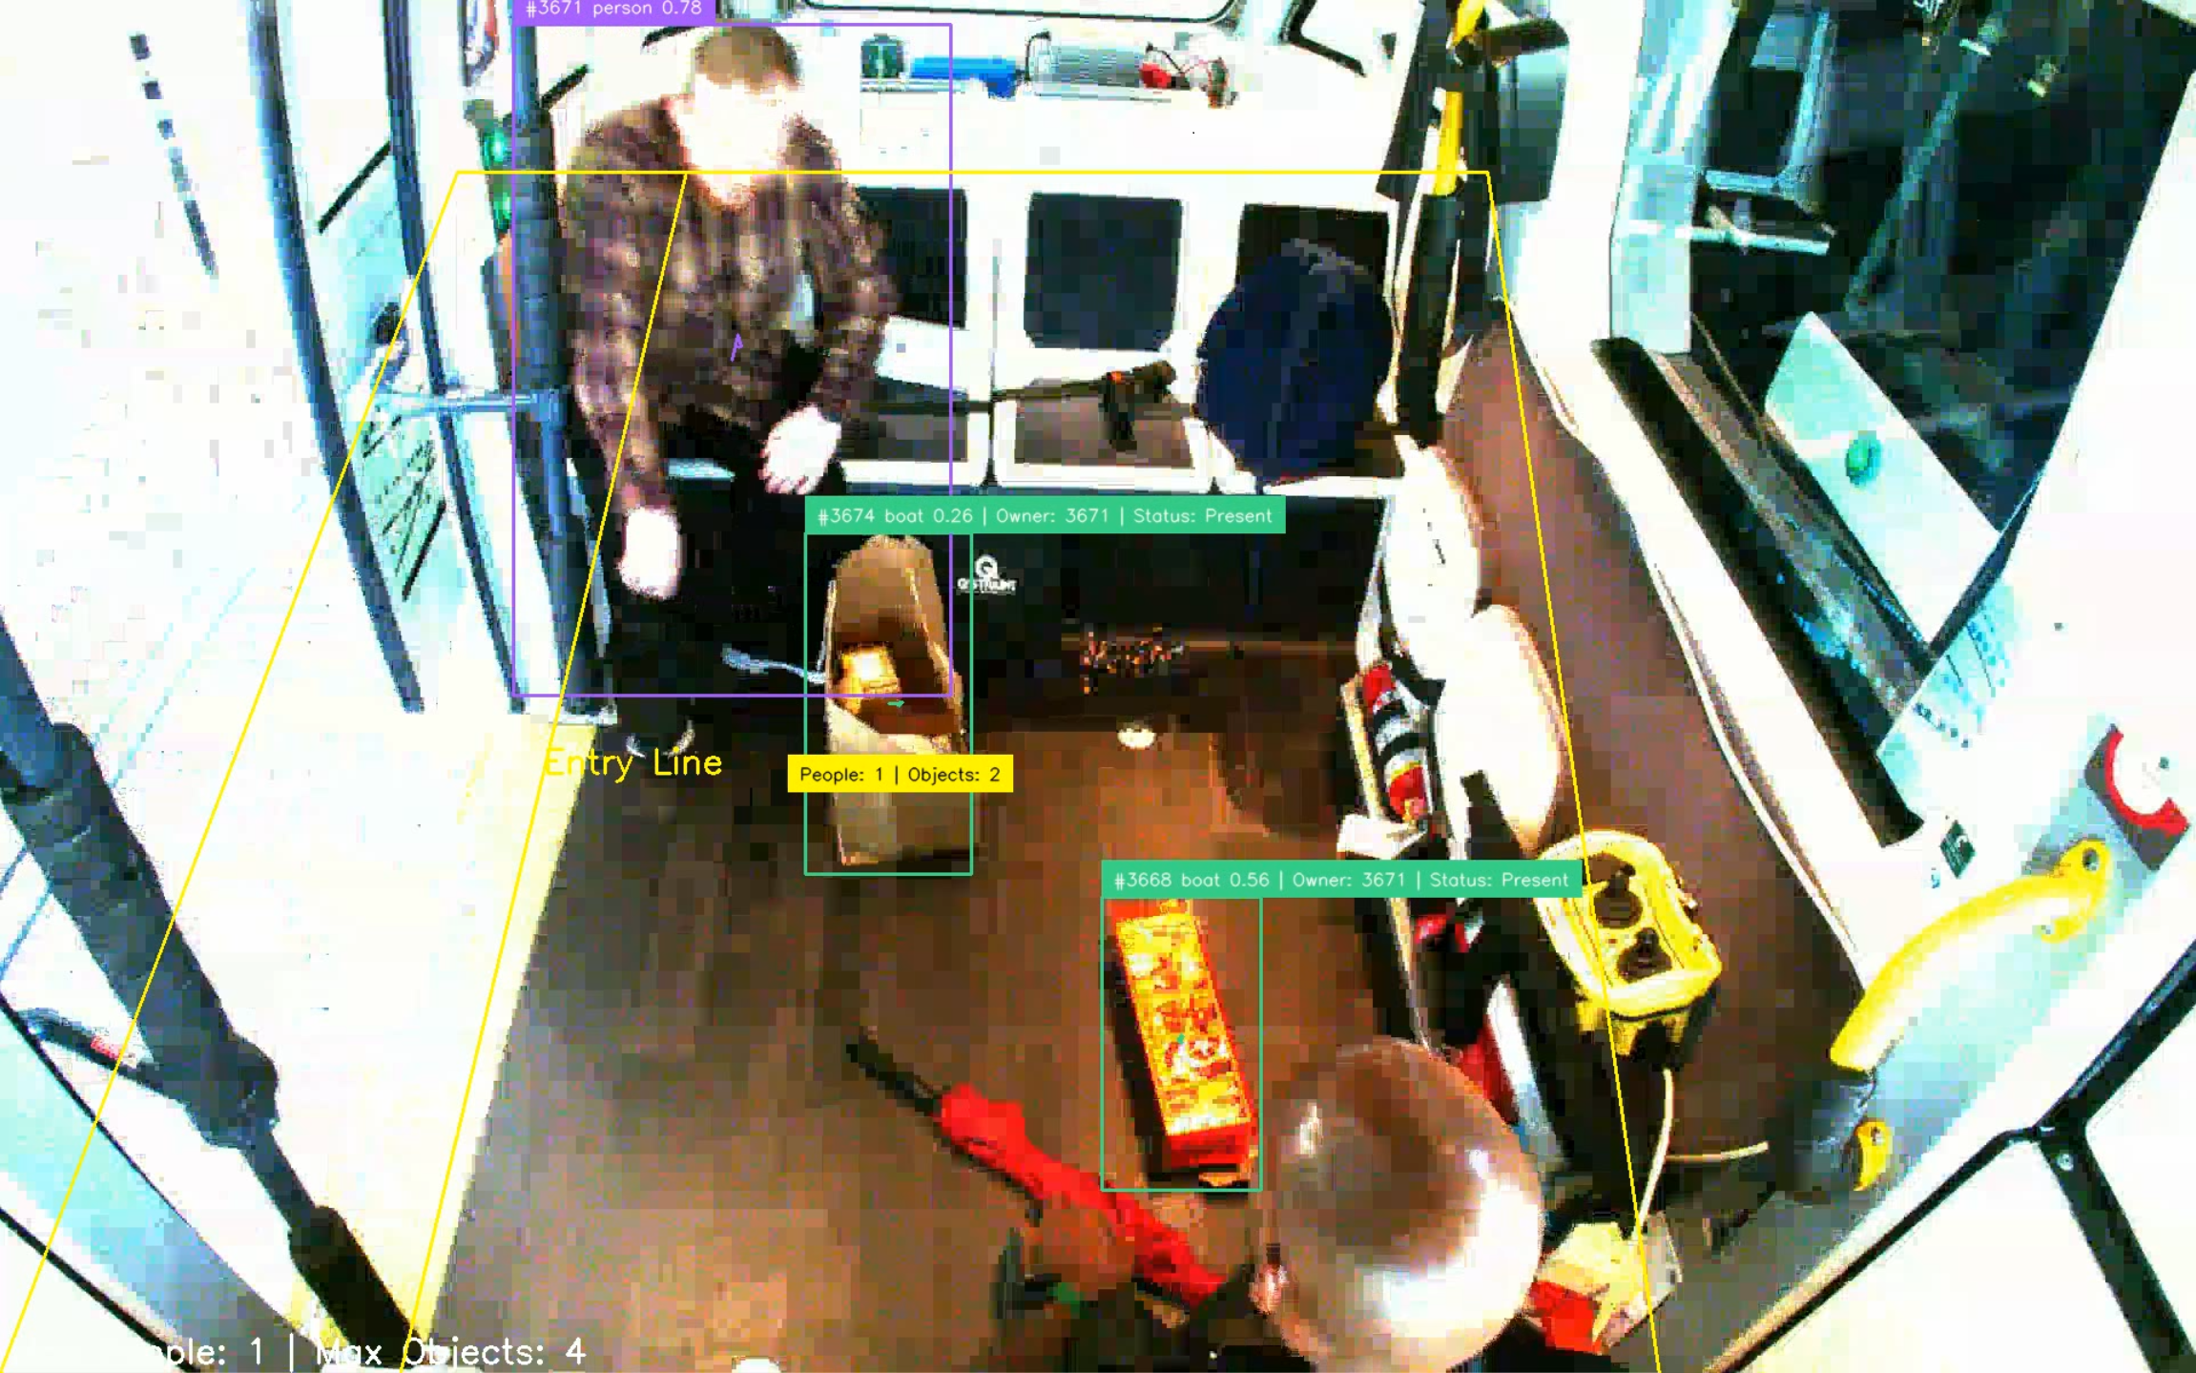
Polygon Zone Detection Filtering
Count of people and objects within the zone
All the detections outside the polygon zone are filtered out

Slide 8
Item-Person Association
We need to associate items with their respective owners and trigger an alert if the owner leaves without the item.
Entry Line Based Assignment: Used to pair an item with its owner when both cross the entry line simultaneously or in quick succession. Once an object is assigned to a person using the entry line method, the assignment is permanent for the duration of the tracking session. This ensures that their association remains intact even if they move around.
Proximity-Based Assignment: Used when the entry line logic does not capture the detection of both a person and their associated object simultaneously. This function ensures that objects are assigned to the nearest detected person based on the distance between their bounding boxes

Slide 9
Item-Person Association
Tracking ID of person #3671
ID of assigned owner #3671 Owner Status : Present
Entry Line

Slide 10
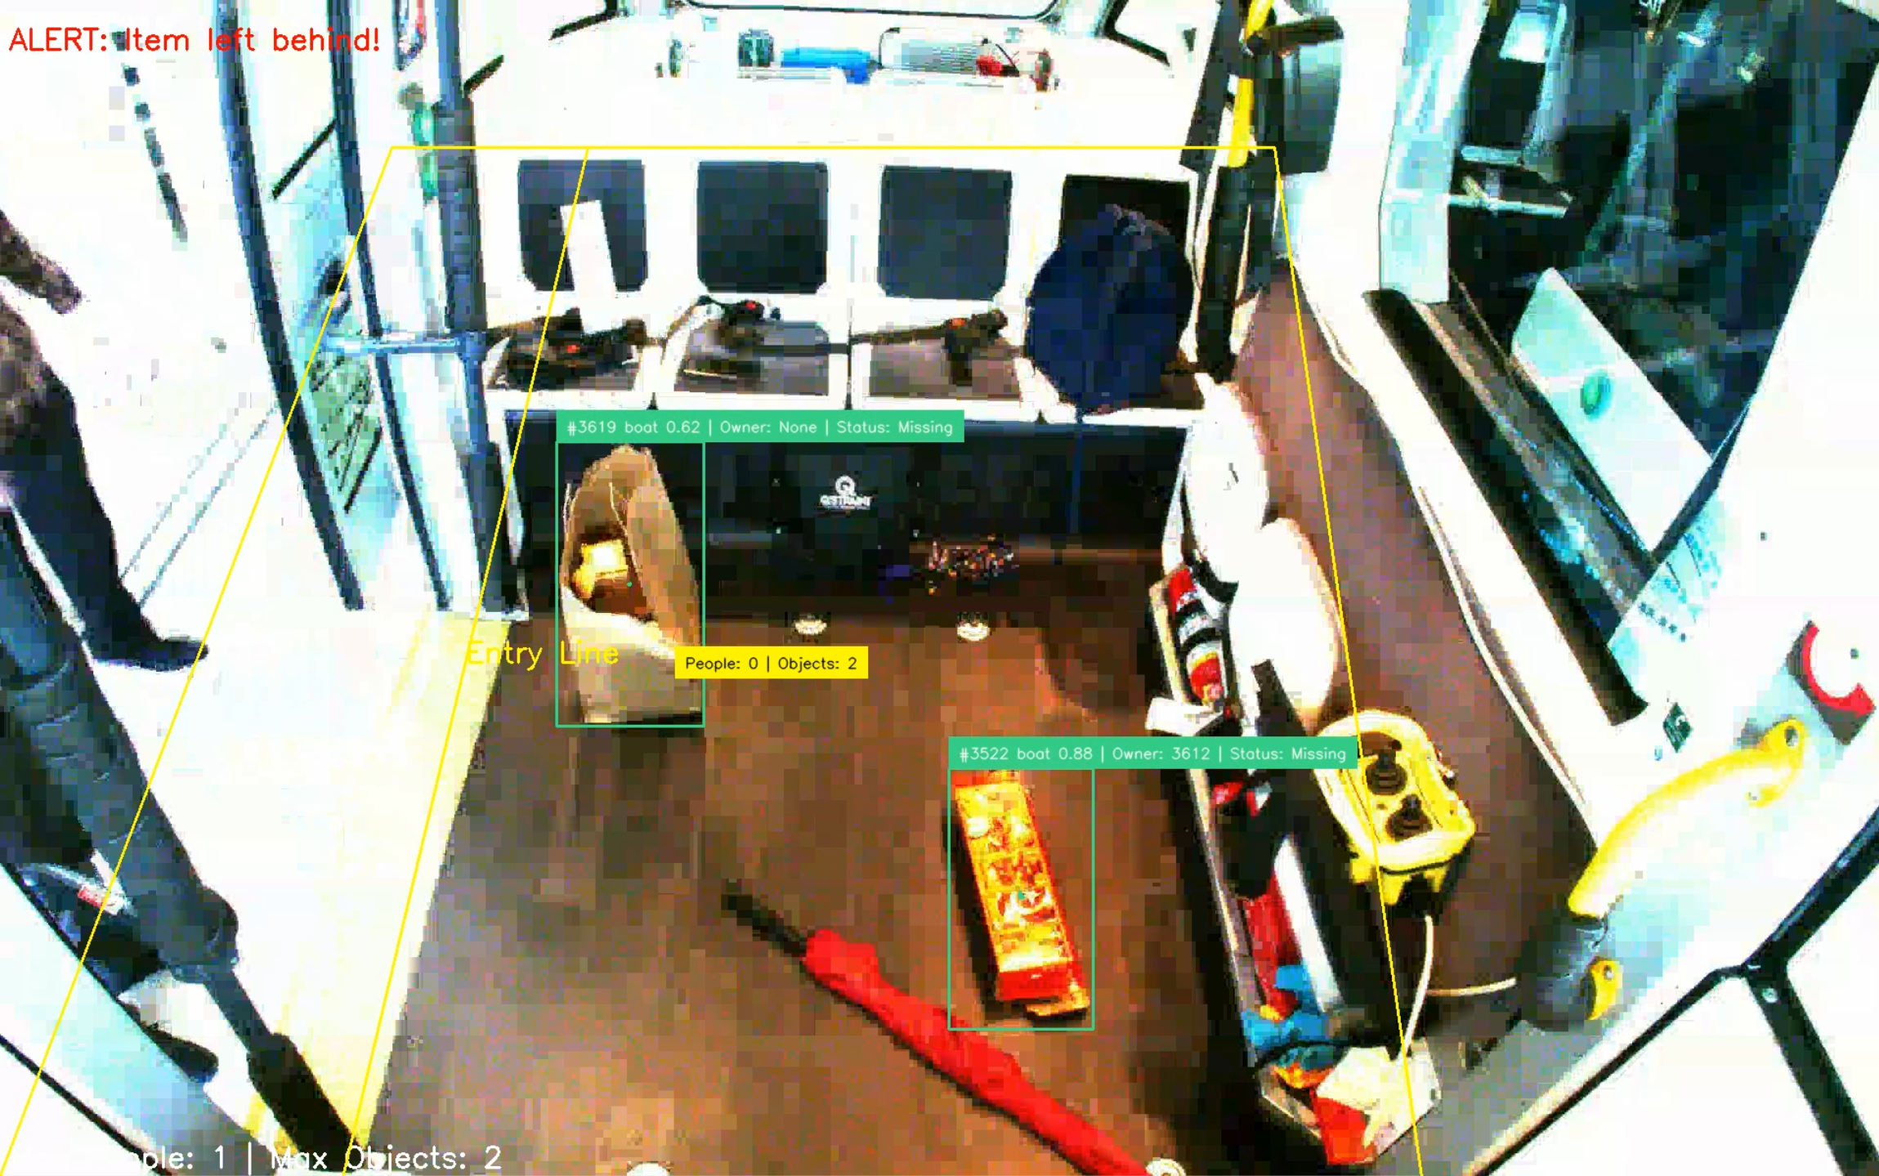
Left behind Item Alert
Alert Trigger: An alert is triggered if the owner is no longer detected and the item remains onboard for more than 5 seconds. This is a user defined variable.
Alert Display
Items with missing owner

Slide 11
Results
Accurately detect and track persons and objects.
Correctly pair items with their owners using entry line and proximity-based methods.
Effectively trigger alerts when items are left behind.

Slide 12
Recommendation and Next Steps
Improve Detection Accuracy: While YOLOv7 is trained on the popular COCO dataset, it is primarily concerned with detecting general items. To improve detection accuracy, we can train the YOLO model on a custom dataset comprising images of common items from the camera feed. This training will account for factors such as camera quality, lighting conditions, and camera angles.
Real-Time Processing: Ensuring real-time processing of video feeds may require optimization of the detection and tracking algorithms.
Integration with Transport Systems: Integration with existing transport management systems to provide real-time alerts to passengers and authorities.
User Feedback: Incorporating feedback from users can help refine the alert mechanisms and improve overall system performance.

Slide 13
Q&A

Slide 14
What is YOLOv7?
Model in the YOLO (You Only Look Once) family of single-stage object detectors.
Architecture:
Backbone: Featurizes image frames.
Neck: Combines and mixes features.
Head: Predicts locations and classes of objects for bounding boxes.
Post-Processing: Uses Non-Maximum Suppression (NMS) to finalize predictions.
Advantages:
Small, nimble, and trainable on a single GPU.
Real-time inference speed with minimal hardware requirements.

Slide 15
What is the COCO dataset?
COCO Dataset Overview
Purpose: Large-scale dataset for object detection, segmentation, and captioning.
Content: Over 330,000 images with 80 object categories and 5 scene descriptions.
Usage: Widely used in computer vision research to train and evaluate models.
Dataset Structure:
Images: Organized into train, validation, and test sets.
Annotations: Provided in JSON format, including:
Image file name and size
Object details (class, bounding box, segmentation mask, keypoints)
Five captions per image

Slide 16
What is ByteTrack?
Purpose: Multi-Object Tracking (MOT) framework presented at ECCV2022.
Key Feature: Associates every detection box, including low-confidence ones, to improve tracking consistency.
Innovation: Keeps non-background low-confidence detection boxes for secondary association, enhancing tracking even with occlusions or appearance changes.
Adaptability: Works with any object detection method (e.g., YOLO, RCNN) and instance association methods (e.g., IoU, feature similarity).
Impact: Adopted by many researchers for their MOT trackers due to its simplicity and effectiveness.

